Slide 1
Study Abroad RAG Assistant
Intelligent Chatbot for University Admission Guidance
Muhtadina Serniabat Tasin — 2232160642
Yousra Amin — 2221044042
Sajin Ahmed Nirjona — 2011108642

Slide 2
Project Objective
The primary objective of this project is to develop an intelligent, user-friendly chatbot that assists students in exploring and understanding the requirements, processes, and tips related to applying to universities abroad.
This assistant is especially helpful for students who:
Are unsure about where to begin their study abroad journey,
Want detailed, trustworthy, and specific information,
Prefer an interactive, conversational interface over traditional search.

Slide 3
Key Features
RAG-based Architecture Combines retrieval with generation for accurate and grounded responses.
PDF as Knowledge Source Uses a trusted domain-specific PDF instead of unreliable web data.
OpenAI Embeddings Converts text into high-dimensional vectors for semantic search.
Supabase Vector Store Efficiently stores and retrieves similar text chunks using embeddings.
Langchain Tool Agent Custom tool-based agent retrieves and processes relevant documents. Prompt from Langchain Hub Uses a pre-optimized OpenAI functions prompt for structured generation.
Fast & Reliable LLM (GPT-4o) Delivers fast, high-quality answers suitable for real-time chat.
Streamlit UI Simple, interactive chat interface for seamless user interaction.
Chat History Preservation Maintains user conversation state to ensure continuity.
Deterministic Responses Temperature set to 0 for predictable, consistent outputs.
Modular Code Design Easy to scale or adapt for future domains or enhancements.
Lightweight Deployment Minimal setup needed—runs locally with cloud-based LLM + vector DB.
Focused on Study Abroad Info Tailored to questions about applying to universities internationally.
Fast PDF Chunking & Indexing Splits documents for efficient retrieval with overlap handling.
Secure API Integration Uses .env variables to keep keys and endpoints safe.

Slide 4
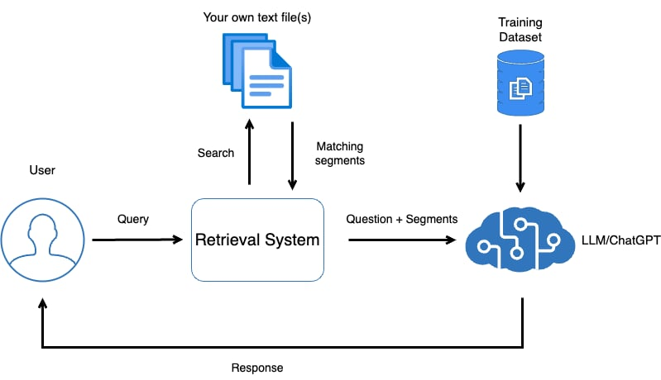
Pipeline Overview
The core of our chatbot is built on a Retrieval-Augmented Generation (RAG) mechanism. When a user submits a query, it is first embedded into a vector using OpenAI’s embedding model. This vector is then used to search for semantically similar chunks from a preprocessed PDF stored in a Supabase vector database. These chunks were previously created by splitting the document into overlapping segments and embedding them during initialization. The top-matching chunks are then passed as context to an LLM — specifically GPT-4o via Langchain’s Tool Agent — which uses this grounded information to generate an accurate and relevant response. The final answer is returned through a Streamlit chat interface, maintaining a smooth, interactive experience.

Slide 5
Components Overview

Slide 6
Data Source:
Input:
A folder containing PDF documents (in documents/ folder)
Processing:
Documents loaded using PyPDFDirectoryLoader
Split into chunks using RecursiveCharacterTextSplitter
Framework Used:
langchain_community.document_loaders
langchain_text_splitters

Slide 7
Vector Store(Supabase):
Function: Stores document embeddings and supports similarity search.
Libraries Used:
SupabaseVectorStore from Langchain
supabase-py client
Output: List of similar documents to query, passed to the LLM.

Slide 8
Embedding Model:
Model Used: text-embedding-3-small from OpenAI
Input: Text chunks from documents Output: Vector embeddings stored in Supabase
Library: langchain_openai.OpenAIEmbeddings

Slide 9
Retrieval Agent:
Tools:
Langchain agent + OpenAI LLM
A custom tool (retrieve()) to query vector store
Prompt: Pulled from Langchain Hub — hwchase17/openai-functions-agent
Logic: Uses tool-calling agent from Langchain to fetch and combine context

Slide 10
Large Language Model(LLM):
Model Used: GPT-4o via ChatOpenAI
Temperature: 0 (focused on factual, deterministic responses)
Role: Synthesizes final answer using:
Retrieved context
User query

Slide 11
Streamlit UI:
UI Features:
Real-time chat interface
Message history management
Styled using st.chat_message
Implementation Steps:
Input box using st.chat_input
Session state to track chat
Display retrieved and generated messages

Slide 12
Timeline:
Weeks | Task Done
Week 1 | Research and planning
Week 2 | Set up Supabase & Langchain basics
Week 3 | Load documents and build embedding pipeline
Week 4 | Develop and test retrieval agent
Week 5 | Build and integrate Streamlit UI
Week 6 | Testing, evaluation, documentation, final touches

Slide 13
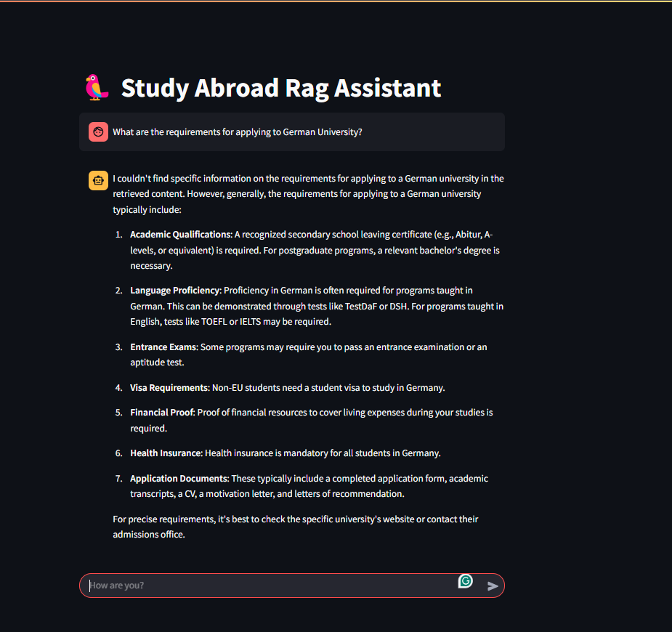
Experiments and Results:
Test Query: “What are the key requirements for applying to German universities?”

Slide 14
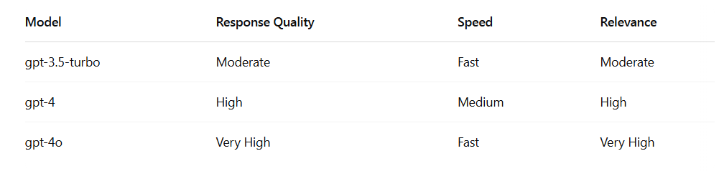
Models Compared:
Conclusion: GPT-4o provides the best trade-off in terms of speed and accuracy.
Light: gpt-3.5-turbo
Moderate: gpt-4
Heavy: gpt-4o

Slide 15
Conclusion:
Future Work:
Successfully developed a RAG-based chatbot for guiding students on studying abroad.
Seamless integration between data retrieval and LLM.
Streamlit UI provides a clean and engaging experience.
GPT-4o is ideal for real-time intelligent responses.
Add support for uploading personalized documents (e.g., transcripts, resumes)
Support multiple languages for international students
Integrate with official university APIs for real-time data

